Slide 1
Models for analysis 1
Summary of models
Bottleneck model Caleb’s sugg. AFS model My suggestion
Contemporary Ne (n1) 1-50,000 1-1.5 million 1-1.5 million
Historic Ne (n3) 1-50,000 1-1.5 million 1-1.5 million
Bottleneck Ne (n2) 1-1,000 1-1000 1-1000
Bottleneck Time (t1) 1-50 1-30 1-30
Pre-bottleneck Time (t2) 1-1,000 15-100 1-1000
Constant Pop Model
All three Ne’s 1-50,000 1-1.5 million 1-1.5 million
Time1 1-1,000 1-100 1-1000
Time2 1-1,000 none none
I went with 50,000 as the top of Ne because I don’t think that Ne would actually be this high in any pop, and because of what we learned from the whales in how prior assumptions will skew posteriors- obviously a discussion point
Suggest keeping same as / similar to before because:
We still include the AFS in our panel of species, for which we previously argue 1-1.5 million is the most appropriate prior
Several species in our panel have contemporary population sizes in the millions, so we should probably keep the priors on historical and contemporary Ne broad so as to comfortably include these species. The crabeater has an estimated 15 million individuals.
Having said that, I‘m happy to go for 1 million if you think this would be better for the species with smaller population sizes.
I think this is OK, although it might be argues that the species that show no support for a bottleneck do so because they were still bottlenecked, but went down to larger numbers, ie. 10k. We could always try repeating the non-bottlenecked species with a wider prior on this parameter, just to be extra thorough.
I think the timing was perfect on the AFS model as most species were effectively hunted at the same time
If I remember correctly, we didn‘t present this last time. I‘m not sure we‘ll present it again, nor am I sure whether it is important to have narrow (as before) or broad priors. I am happy to go with 1-1000.
I thought there was just one time prior for the constant model?
mu microsatellite = 1-10 X 10-4 as before?
I fully take your point, but it‘s a bit wierd if our generalised model has Ne priors that could be viewed as a bit lean for the species with larger population sizes. Perhaps we could run the models with wide priors and check out the results. One possibility would be to target the Ne priors much more tightly for the species-specific models, as we know contemporary NE for most species!

Slide 2
Sex ratio is a parameter I am a little concerned about. Not really certain on how this assumption will actually influence the results, but rather the availability of this data for each species. For example in one species, a 20:1 is reported (and they do have an unusual gang-rape strategy), and in another, all that is available is ‘doesn’t differ from 1:1 at birth and weaning’…..

Slide 3
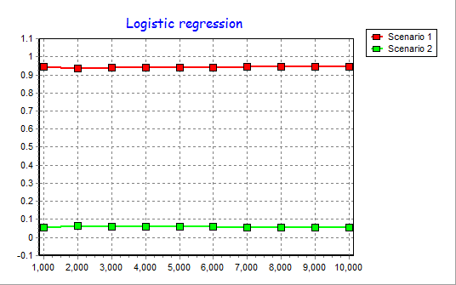
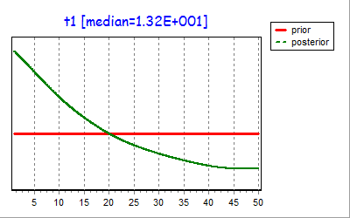
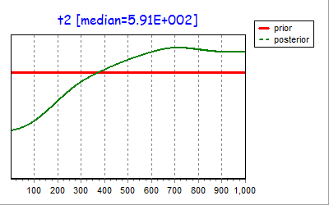
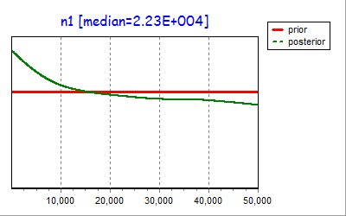
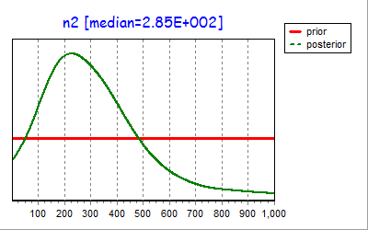
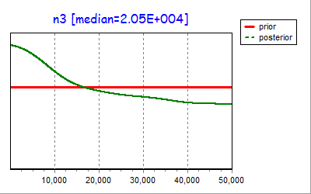
Mediterranean Monk Seal
1:1 sex ratop (Gazo et al. 1999)

Slide 4
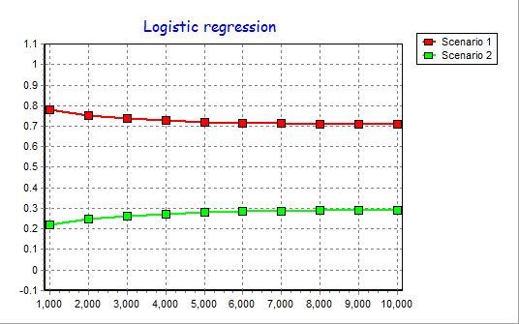
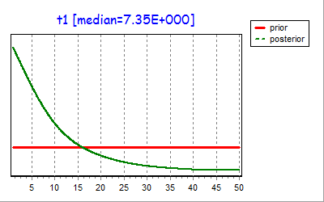
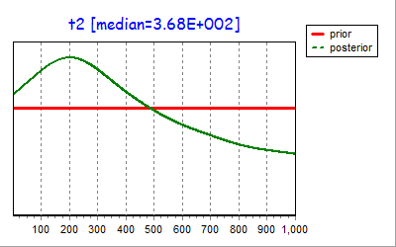
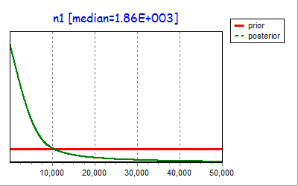
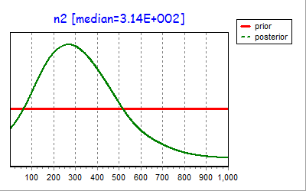
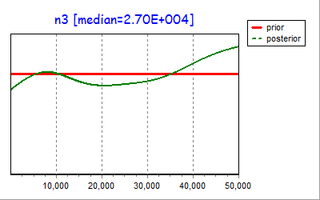
Northern Elephant Seal
sex ratio at birth and at weaning rarely varies from parity
(Le Boeuf et aI., 1989a;Stewart, 1989)- I assumed 1:1

Slide 5
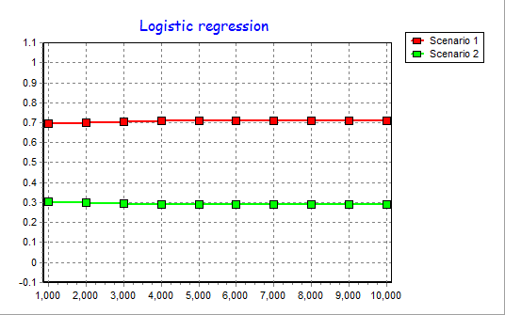
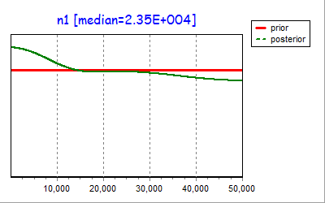
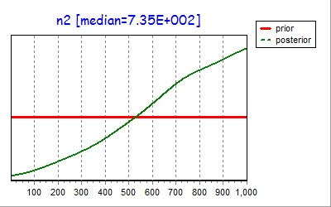
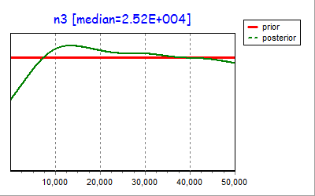
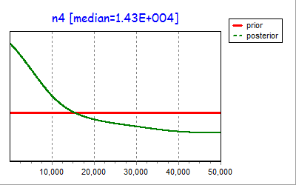
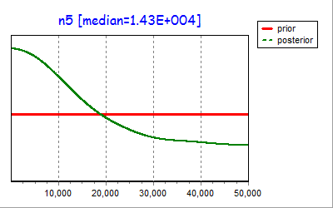
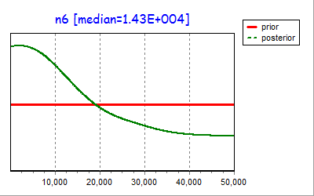
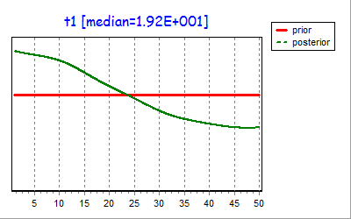
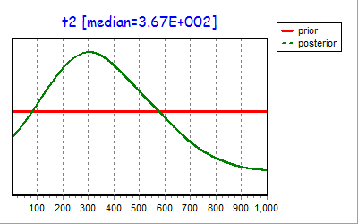
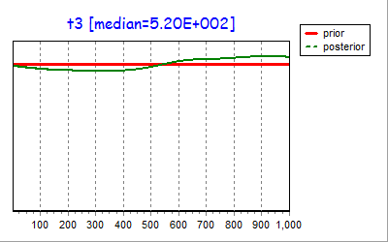
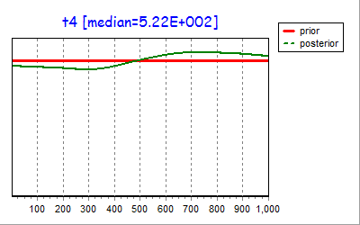
California Sea Lion
Assumed 1:1

Slide 6
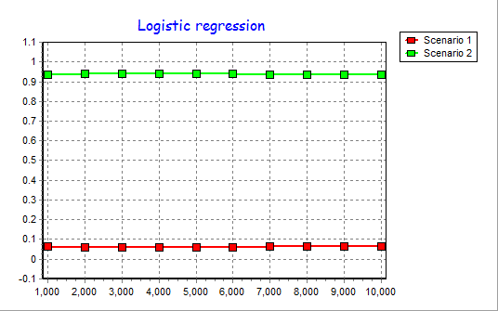
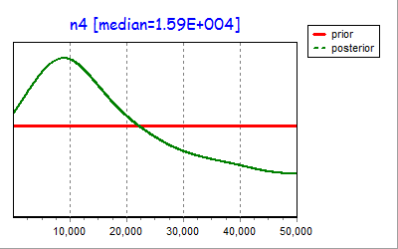
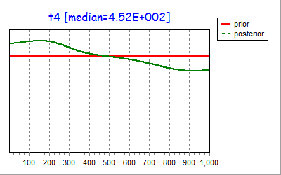
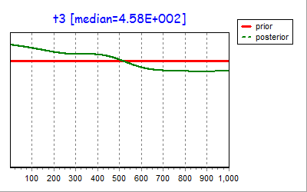
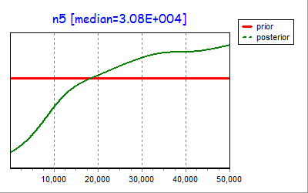
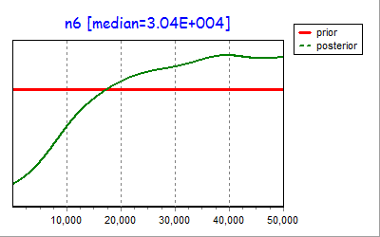
Southern Elephant Seal
20:1 cow:bull ratio assumed

Slide 7
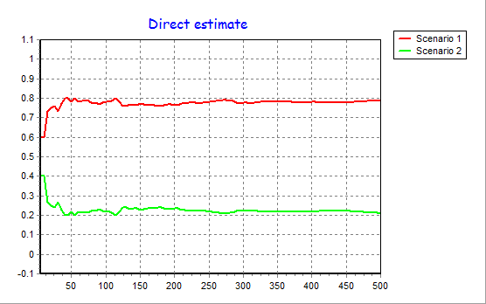
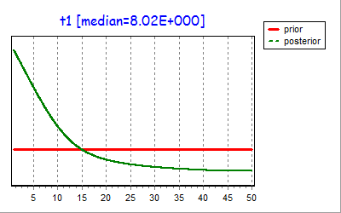
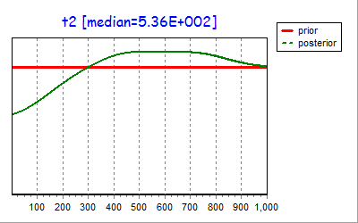
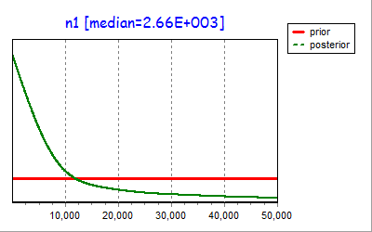
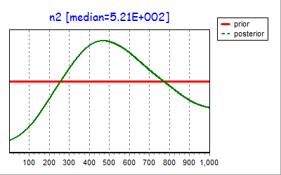
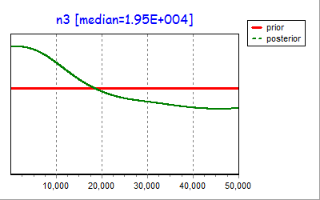
Hawaiian Monk Seal

